Slide 1


Integration of Rent a Car with Fleet Solutions

Slide 2
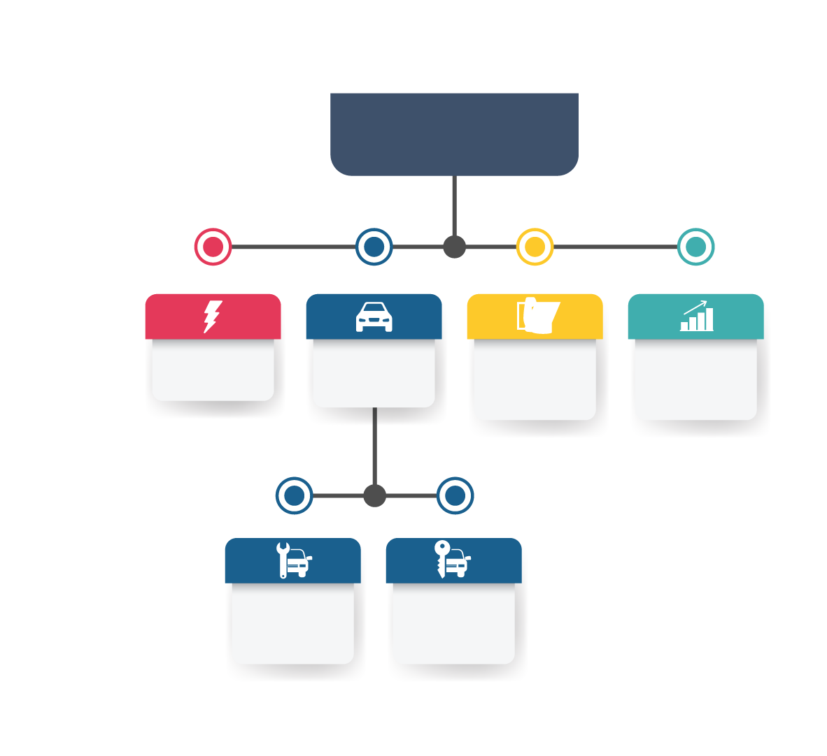




Koç Group
Energy
Automotive
Consumer
Durables
Finance
Automotive
Manufacturing
Car Rental
Fleet Solutions
Dealership
Otokoç Otomotiv

Slide 3
Koç Holding & Otokoç Otomotiv – Key Highlights
Koç Holding A.Ş
Fortune 500 Global: 381st
Sales: $25.5 Bn
Net Profit: $1.3 Bn
Assets: $25.1 Bn
Market capitalization: $9.5 Bn
MSCI Turkey: 5th rank in MSCI Turkey index
Otokoç Otomotiv A.Ş
Sales: $ 1.9 Bn
31st biggest company in Turkey
Holding 8% of new car sales in Turkey-
(79,000 new and 24,000 used car)
Market leader in Rent a Car
57% market share and 16,000 vehicles
Strong Operational Leasing position with 9.1% market share and 23.850 vehicles
Turnover Million EUR

Slide 4
Otokoç Otomotiv – Milestones
Otokoç:
First Ford Dealership
Egemak:
First Fiat Dealership
Avis TR
Licence agreement
Avis Azerbaijan
Birmot Merger
Otokoç & Birmot & Avis Merger
Otokoç Merger
Avis
Northern Iraq
Zipcar TR Licence agreement
Budget
Northern Cyprus
Budget TR Licence agreement
Otokoç First Volvo
Dealership
Otokoc Hungary Kft.
Budget Hungary
Otokoç Insurance
Avis
Kazakhstan
Zipcar Turkey
Budget
Georgia
Budget
Ukraine

Slide 5
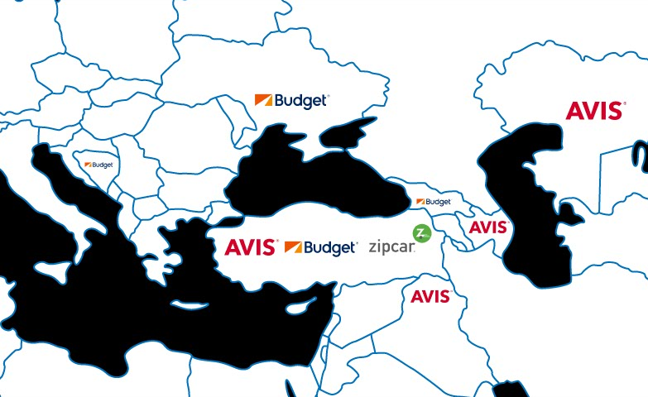

Slide 6
Otokoç Georgia – Budget
Our Mission
To develop new innovative solutions
To cover the entire life cycle of corporate fleet management
To become a significant player of the mobility market

Slide 7
Otokoc Georgia at a Glance
Otokoc Georgia LLC is the holder of the master franchise of Budget Rent a Car in Georgia.
It is a 100% subsidiary of Otokoc Otomotiv Turkey.
Budget started its active operations in Georgia in September 2016.
The company is currently based in Tbilisi with one downtown office in Rose Revolution Square and the other at Shota Rustaveli Tbilisi International Airport.
Budget is involved in the short-term rental and long-term leasing of vehicles, with long-term leasing accounting for c.52% of operations in terms of revenue.
The Company has a diversified offering, catering to leisure, business, and insurance markets in RAC, as well as large corporates, SMBs and individuals in the LTR market
Operating Segments:
- LTR: Car rentals >1 year to corporations, SMBs and individuals (typically 3-4 years)
- RAC: Car rentals <1 year to leisure, business and insurance / leasing customers
- Fleet management: Procurement, fleet management and remarketing
- Sale and leaseback

Slide 8
The particularities of Rent a Car & Operational Leasing
 | Rent a Car | Classic Operational Lease
Period | From 1 day to maximum 1 year | From 1 years to 4 years
Price | Expensive (with the same parameters + 40%) | Optimized
Flexibility | Flexible, it can be cancelled any time | Not flexible, penalty fee in case of cancellation
Running | Max 3500 km/month limit | According to agreement, no limits
Insurance | High risk- high down payment | Casco
Vehicles | Younger than two years, maximum with 40.000 Km | High mileage, aging fleet towards the end of the period
Usage | Tourism- private rentals, casual corporate rentals, periodical project jobs, replacement cars for corporate fleets, internship programs | Managerial cars, regional representatives, sales colleagues, pool car, goods transport
Model | Holding cost + expected profit | Financing + taxes + insurances + other linked services + expected profit
Goal | To rotate the entire fleet within one business year, to utilize the fleet at the best capacity, to produce the holding cost at the soonest | A stable long term income source, pre-calculated risk and P&L.

Slide 9
Operational Leasing Advantages
Comfort service
Rational financial decision
Selection and acquisition of vehicles
Fleet Handling: all kind of services related to everyday vehicle operations
  Fuel management
  Tire management
  Repair services
  Replacement car
  Pick up and delivery
  Billing reporting
  Insurance and registration
Assistance & Consulting
No need to tie up capital in the vehicles
To use saved funds for core business
Favorable and predictable costs
Easy accounting, vehicles are not part of the balance sheet
Depreciation and risk are borne by the lessor
The residual value is granted in the beginning of the leasing

Slide 10
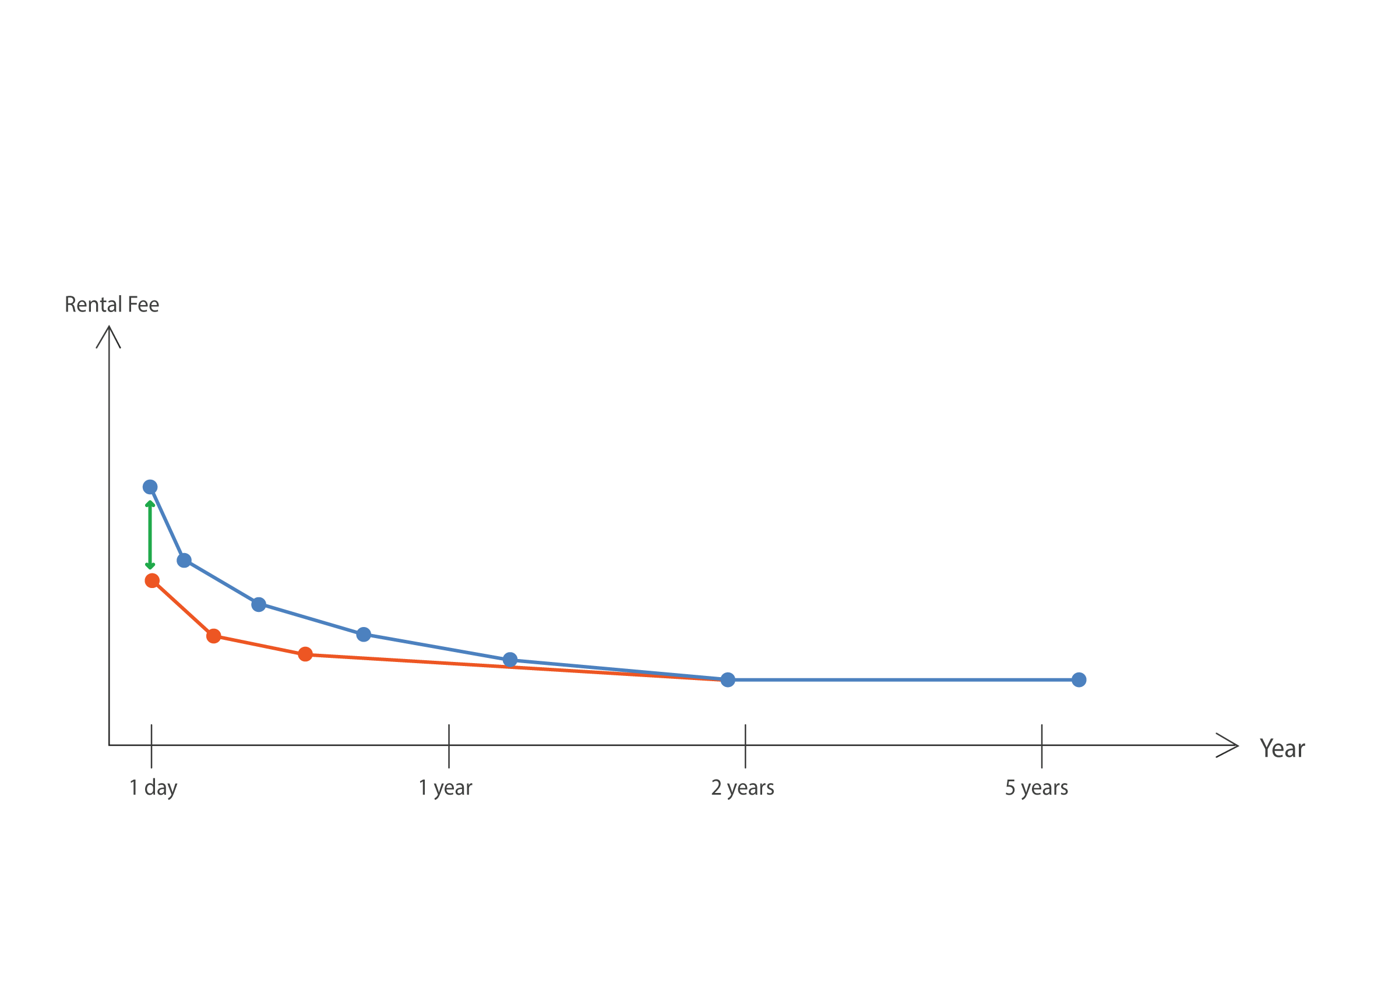
2 in 1 formula
Rent a Car
Fleet Solutions
Extension of the operating leasing model for one-year term and use this for shorter periods too by utilizing the flexibility of our Rent a Car fleet making sure that the holding cost is covered.
Internship programs
Production Orders
Services and Total Loss
Project Jobs

Slide 11
2 in 1 formula
The newly acquired corporate partners with reasonable prices give a more balanced income to our Rent a Car business unit
Favorable prices (-20%-30%) achieved with this new model are easy gain without pain for our customers
A whole new service implemented in the Operational Leasing model gives us a unique position in the market

Slide 12
Sample Quotation
Terms & Conditions;
Price Includes;
Periodic Maintenance,
Insurance ( up to 50.000 USD TPL )
Replacement Car During Maintenance & Accident,
Winter Tyres
Price Excludes;
VAT ( %18 ) , Fuel

Slide 13
Contact Details
Berat Ecemis
Country Manager
Budget Rent A Car
Otokoc Georgia LLC
37 Rustaveli Avenue
Tbilisi / Georgia
Office: + 995 322 234 112
berat@budget.com.ge
Irakli Tsulaia
Sales Specialist-Long Term
Budget Rent a Car
Otokoc Georgia LLC
37 Rustaveli Avenue.Tbilisi,Georgia
Office:+995 322 234 112
Mob: +995 599 234 267
irakli.tsulaia@budget.com.ge

